Slide 1
The Sporadic Server
Hochschule Hamm-Lippstadt
Real-Time Systems Seminar Paper
Name: Faysal Ahammed Tonmoy
Matriculation: 1230473
Sporadic Server | Faysal Ahammed Tonmoy | ID 1230473
Sporadic Server | Faysal Ahammed Tonmoy | ID 1230473
1

Slide 2
What is a Real-Time System?
A late correct result can still be a system failure.
Braking decision: correct but too late is unsafe
Motor control: late update can destabilize the system
Alarm handling: timing decides whether reaction is useful
Correct Result
Correct Timing
Real-Time System
Sporadic Server | Faysal Ahammed Tonmoy | ID 1230473

Slide 3
Why is a Sporadic Server Needed?
Periodic hard tasks
regular + deadlines
Aperiodic requests
irregular + need response
Scheduling conflict
fast vs. safe
Two naive choices are not enough:
Need:
Controlled service for
aperiodic jobs
Background only: safe but slow response
Uncontrolled high priority: fast but can break deadlines
Sporadic Server | Faysal Ahammed Tonmoy | ID 1230473

Slide 4
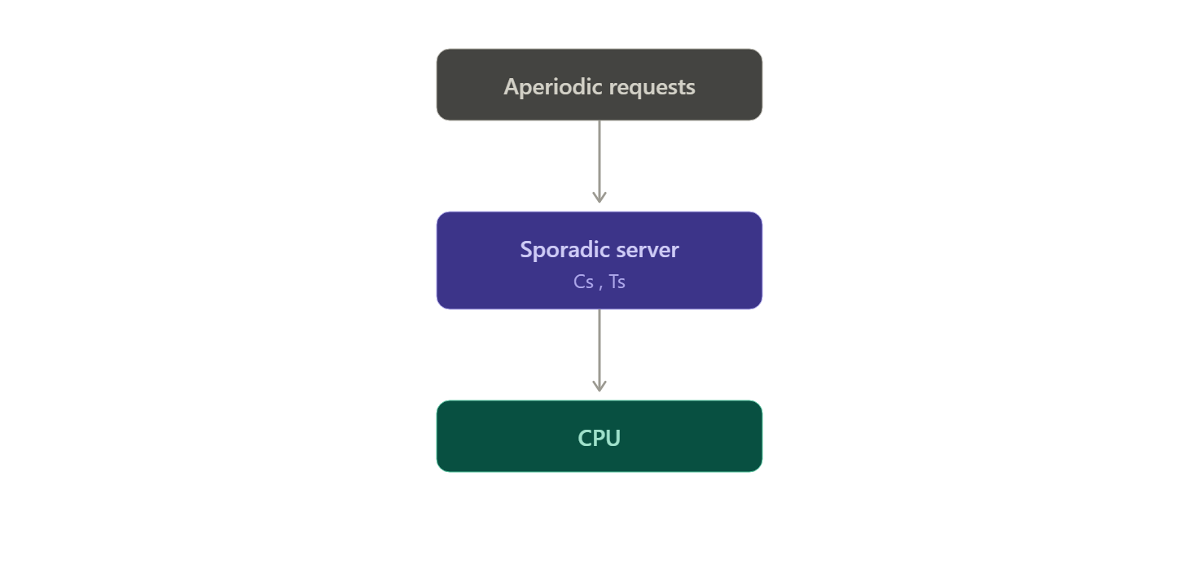
What is the Sporadic Server?
The Sporadic Server gives aperiodic jobs a limited CPU budget.
If budget is available, an aperiodic job can run at server priority. If the budget is exhausted, the job waits until the consumed capacity is replenished later.
One-line idea:
Controlled CPU wallet for irregular jobs
Created via PlantUML
Based on Sprunt, Sha, and Lehoczky; explained in Buttazzo as a fixed-priority server.
Sporadic Server | Faysal Ahammed Tonmoy | ID 1230473

Slide 5
Behaviour
Aperiodic
job arrives
Server checks
budget
Budget > 0
job runs
Budget decreases
Cs → Cs−1
Budget = 0
job waits
Later: consumed capacity is replenished
Periodic hard task has priority over the server.
Sporadic Server | Faysal Ahammed Tonmoy | ID 1230473

Slide 6
Budget Replenishment
Time
Budget = 2
Aperiodic Job Run
1 unit used
Budget =1
1 unit used
Budget =0
Wait
Ts = 5
Budget Replenished
Restored Budget = 2
Result: Aperiodic jobs get fast response, but cannot overload the CPU
Sporadic Server | Faysal Ahammed Tonmoy | ID 1230473

Slide 7
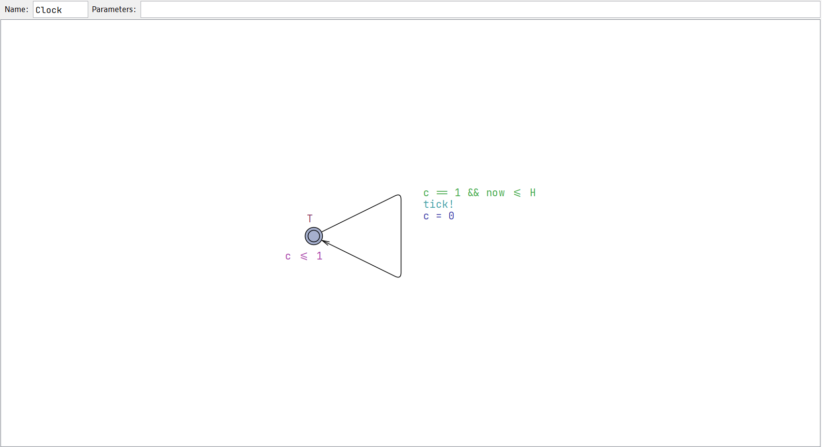
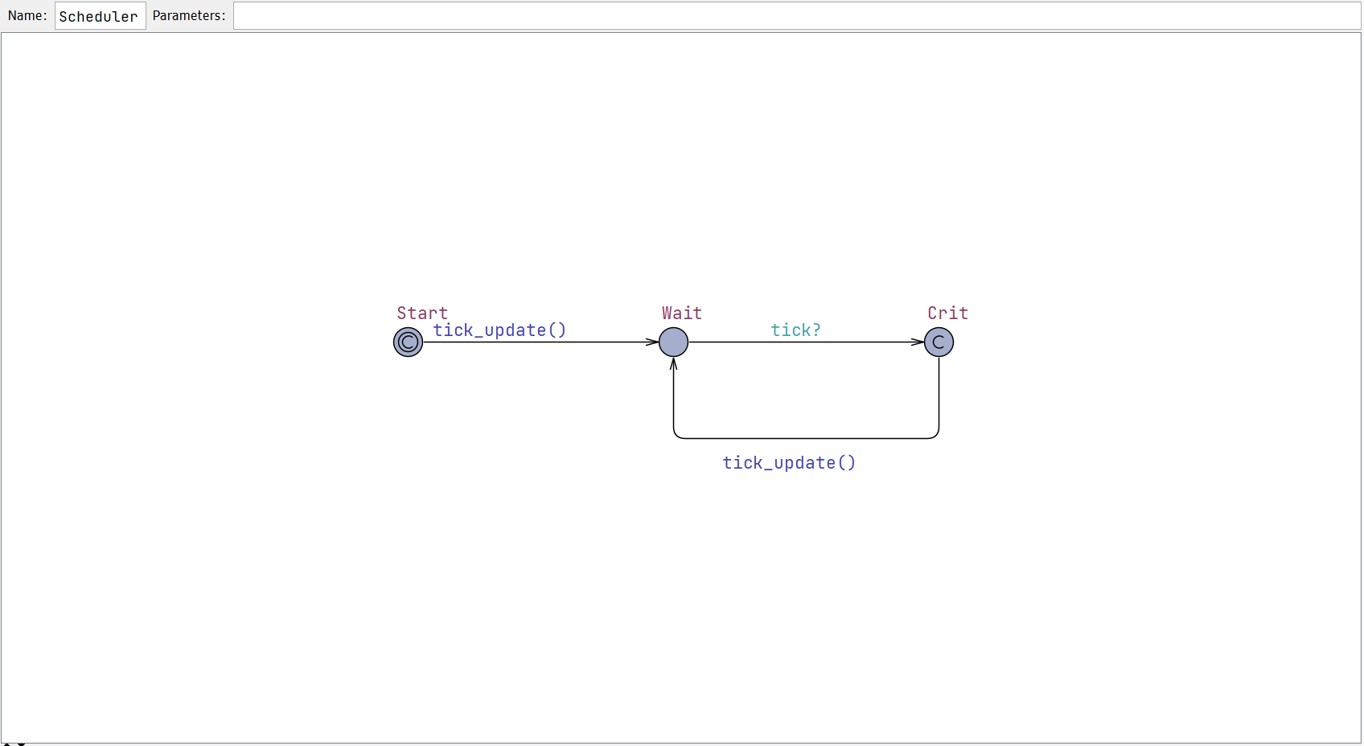
Main Feature
Model components
Clock template sends tick every time unit
Scheduler receives tick and performs one atomic update
Update handles release, arrival, budget, replenishment, deadline check
Priority order: periodic task > Sporadic server
UPPAAL shows timing logic
without needing a full RTOS implementation
Sporadic Server | Faysal Ahammed Tonmoy | ID 1230473

Slide 8
Parameters and Properties
Parameters
Tp = 4
period
Queries / checks
Cp = 1
periodic execution
Budget stays within valid bounds
Periodic task never misses deadline
Aperiodic queue remains bounded
Server becomes active
Budget can be exhausted
All modeled aperiodic jobs can be served
Dp = 4
deadline
Cs = 2
server budget
Ts = 5
replenishment
QMAX = 3
queue bound
Most important query: A[] not miss
Sporadic Server | Faysal Ahammed Tonmoy | ID 1230473

Slide 9
Critical Evaluation and Final Message
Advantages
Limitations
Better response than background scheduling
Protects periodic hard tasks using bounded budget
Analyzable with Cs and Ts
Good for bounded irregular events
Needs accurate timer and budget accounting
More scheduler bookkeeping
Does not solve continuous overload
Shared resources need extra protocols
Core references: Sprunt, Sha & Lehoczky (1989); Buttazzo (2011).
Sporadic Server | Faysal Ahammed Tonmoy | ID 1230473

Slide 10
Thank you for your attention
Sporadic Server | Faysal Ahammed Tonmoy | ID 1230473

